Slide 1
Part 1:
Java as an Object-oriented Programming Language
00. Introduction to Java

Slide 2
Java History
James Gosling and Sun Microsystems
Oak
Java, May 20, 1995, Sun World
HotJava
  The first Java-enabled Web browser
JDK Evolutions
J2SE, J2ME, and J2EE

Slide 3
JDK Editions
Java Standard Edition (J2SE)
  J2SE can be used to develop client-side standalone applications or applets.
Java Enterprise Edition (J2EE)
  J2EE can be used to develop server-side applications such as Java servlets and Java ServerPages.
Java Micro Edition (J2ME).
  J2ME can be used to develop applications for mobile devices such as cell phones.

Slide 4
Java IDE Tools
Text Pad
Net Bean
Eclipse
InteliJ

Slide 5
Your first Java program!
public class Hello {
public static void main(String[] args) {
System.out.println("Hello, world!");
}
}
What does this code output (print to the user) when you run (execute) it?

Slide 6



Compiling a program
Before you run a program, you must compile it.
compiler: Translates a computer program written in one language (i.e., Java) to another language (i.e., byte code)‏
Compile (javac)
Execute (java)
source code
(Hello.java)‏
byte code
(Hello.class)‏
output

Slide 7
The Java Virtual Machine
(JVM, or VM)
The Java Virtual Machine executes byte code
  Use the “java” command to execute it
  It only understands byte code (“.class” files)
The VM makes Java a bit different from older programming languages (C, C++)
  It’s an extra step; compilers for other languages directly produce machine code
  It’s slower
  But it allows the same byte code to run on any machine with a VM

Slide 8
System.out.println
System.out.println: A statement to print a line of output to the console.
  pronounced “print-linn”
Two ways to use System.out.println:
  System.out.println("<message>");
  Prints the given message as a line of text to the console.
  System.out.println();
  Prints a blank line to the console.

Slide 9
A Java Program
Class name
Main method
Statements
Statement terminator
Reserved words
Comments
Blocks

Slide 10
Class Name
Every Java program must have at least one class. Each class has a name. By convention, class names start with an uppercase letter. In this example, the class name is Welcome.
// This program prints Welcome to Java!
public class Welcome {
public static void main(String[] args) {
System.out.println("Welcome to Java!");
}
}

Slide 11
Main Method
Line 2 defines the main method. In order to run a class, the class must contain a method named main. The program is executed from the main method.
// This program prints Welcome to Java!
public class Welcome {
public static void main(String[] args) {
System.out.println("Welcome to Java!");
}
}

Slide 12
Statement
A statement represents an action or a sequence of actions. The statement System.out.println("Welcome to Java!") in the program in Listing 1.1 is a statement to display the greeting "Welcome to Java!“.
// This program prints Welcome to Java!
public class Welcome {
public static void main(String[] args) {
System.out.println("Welcome to Java!");
}
}

Slide 13
Statement Terminator
Every statement in Java ends with a semicolon (;).
// This program prints Welcome to Java!
public class Welcome {
public static void main(String[] args) {
System.out.println("Welcome to Java!");
}
}

Slide 14
Reserved words
Reserved words or keywords are words that have a specific meaning to the compiler and cannot be used for other purposes in the program. For example, when the compiler sees the word class, it understands that the word after class is the name for the class.
// This program prints Welcome to Java!
public class Welcome {
public static void main(String[] args) {
System.out.println("Welcome to Java!");
}
}

Slide 15

Blocks
A pair of braces in a program forms a block that groups components of a program.

Slide 16
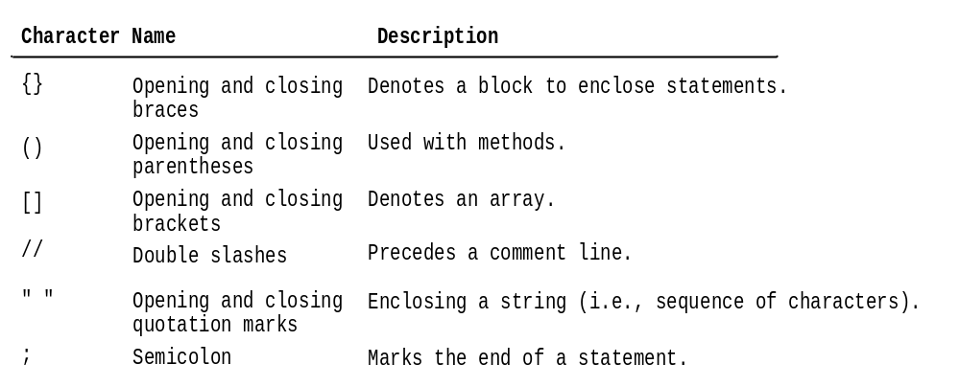
Special Symbols

Slide 17
Programming Style and Documentation
Appropriate Comments
Naming Conventions
Proper Indentation and Spacing Lines
Block Styles

Slide 18
Appropriate Comments
Include a summary at the beginning of the program to explain what the program does, its key features, its supporting data structures, and any unique techniques it uses.
Include your name, class section, instructor, date, and a brief description at the beginning of the program.

Slide 19
Naming Conventions
Choose meaningful and descriptive names.
Class names:
  Capitalize the first letter of each word in the name. For example, the class name ComputeExpression.

Slide 20

Block Styles
Use end-of-line style for braces.

Slide 21
Programming Errors
Syntax Errors
  Detected by the compiler
Runtime Errors
  Causes the program to abort
Logic Errors
  Produces incorrect result

Slide 22
Syntax Errors
public class ShowSyntaxErrors {
public static main(String[] args) {
System.out.println("Welcome to Java);
}
}

Slide 23
Runtime Errors
public class ShowRuntimeErrors {
public static void main(String[] args) {
System.out.println(1 / 0);
}
}

Slide 24
Logic Errors
public class ShowLogicErrors {
public static void main(String[] args) {
System.out.print("Celsius 35 is ");
System.out.print("Fahrenheit ");
System.out.println((9 / 5) * 35 + 32);
}
}

Slide 25
Primitive data types, expressions, and variables

Slide 26
Primitive types
Java has eight primitive types. Here are two examples:
  Name Description Examples
  int integers 42, -3, 0, 926394
  double real numbers 3.4, -2.53, 91.4e3
Numbers with a decimal point are treated as real numbers.
Question: Isn’t every integer a real number? Why bother?
Notes:
“How many sisters do you have?” versus “How much sisters do you have?”

Slide 27
Other Primitive Data Types
Discrete Types
byte
short
int
long
Continuous Types
float
double
Non-numeric Types
boolean
char

Slide 28
Data Type Representations
Type | Representation | Bits | Bytes | #Values
boolean | true or false | 1 | N/A | 2
char | ‘a’ or ‘7’ or ‘\n’ | 16 | 2 | 2¹⁶ = 65,536
byte | …,-2,-1,0,1,2,… | 8 | 1 | 2⁸ = 256
short | …,-2,-1,0,1,2,… | 16 | 2 | 2¹⁶ = 65,536
int | …,-2,-1,0,1,2,… |  | 4 | > 4.29 million
long | …,-2,-1,0,1,2,… |  | 8 | > 18 quintillion
float | 0.0, 10.5, -100.7 | 32
double | 0.0, 10.5, -100.7 | 64

Slide 29
Precision in real numbers
The computer internally represents real numbers in an imprecise way.
Example:
  System.out.println(0.1 + 0.2);
  The output is 0.30000000000000004!

Slide 30
Concatenation: Operating on strings
string concatenation: Using the + operator between a string and another value to make a longer string.
Examples:
  "hello" + 42 is "hello42"
  1 + "abc" + 2 is "1abc2"
  "abc" + 1 + 2 is "abc12"
  1 + 2 + "abc“ is "3abc"
  "abc" + 9 * 3 is "abc27" (what happened here?)‏
  "1" + 1 is "11"
  4 - 1 + "abc“ is "3abc"
  "abc" + 4 - 1 causes a compiler error. Why?

Slide 31
Overflow example
int n = 2000000000;
System.out.println(n * n);
// output: -1651507200
the result of n*n is 4,000,000,000,000,000,000 which needs 64-bits:
---------- high-order bytes -------
00110111 10000010 11011010 11001110
---------- low order bytes --------
10011101 10010000 00000000 00000000
In the case of overflow, Java discards the high-order bytes, retaining only the low-order ones
In this case, the low order bytes represent 1651507200, and since the right most bit is a 1 the sign value is negative.

Slide 32
Declaring variables
To create a variable, it must be declared.
Variable declaration syntax:
  <type> <name>;
Convention: Variable identifiers follow the same rules as method names.
Examples:
int x;
double myGPA;
int varName;

Slide 33
Boolean Arithmetic

Slide 34
The boolean Type
The boolean type has two possible values:
true and false
boolean variables are declared and initialized just like other primitive data types:
boolean iAmSoSmrt = false; //just like int i = 2;
boolean minor = (age < 21); //just like int x = y*2;

Slide 35
Relational expressions
Relational expressions have
  numeric arguments and
  boolean values.
They use one of the following six relational operators:
Operator
Meaning
Example
Value
==
equals
1 + 1 == 2
true
!=
does not equal
3.2 != 2.5
true
<
less than
10 < 5
false
>
greater than
10 > 5
true
<=
less than or equal to
126 <= 100
false
>=
greater than or equal to
5.0 >= 5.0
true

Slide 36
Class Constants
A class constant is a variable
  whose scope is the entire class, and
  whose value can never change after it has been initialized.
To give it the right scope, simply declare it right inside the class:
public class MyClass {
public static final int myConstant = 4;
}
The final keyword means its value can’t be changed.

Slide 37
Scanner objects

Slide 38
Interactive programs
We have written programs that print console output.
It is also possible to read input from the console.
  The user types the input into the console.
  The program uses the input to do something.
  Such a program is called an interactive program.

Slide 39
Scanner
Constructing a Scanner object to read the console:
  Scanner <name> = new Scanner(System.in);
Example:
  Scanner console = new Scanner(System.in);

Slide 40
Scanner methods
Some methods of Scanner:
Each of these methods pauses your program until the user types input and presses Enter.
  Then the value typed is returned to your program.
Method
Description
nextInt()‏
reads and returns user input as an int
nextDouble()‏
reads and returns user input as a double
next()‏
reads and returns user input as a String

Slide 41
Using a Scanner object
Example:
  System.out.print("How old are you? "); // prompt
  int age = console.nextInt();
  System.out.println("You'll be 40 in " + (40 - age)‏
  + " years.");
prompt: A message printed to the user, telling them what input to type.

Slide 42
Input tokens
token: A unit of user input, as read by the Scanner.
  Tokens are separated by whitespace (spaces, tabs, new lines).
  How many tokens appear on the following line of input?
  23 John Smith 42.0 "Hello world"
When the token doesn't match the type the Scanner tries to read, the program crashes.
  Example:
  System.out.print("What is your age? ");
  int age = console.nextInt();
  Sample Run:
  What is your age? Timmy
  InputMismatchException:
  at java.util.Scanner.throwFor(Unknown Source)‏
  at java.util.Scanner.next(Unknown Source)‏
  at java.util.Scanner.nextInt(Unknown Source)‏
  ...

Slide 43
Importing classes
Java class libraries: A large set of Java classes available for you to use.
  Classes are grouped into packages.
  To use the classes from a package, you must include an
  import declaration at the top of your program.
  Scanner is in a package named java.util
Import declaration, general syntax:
  import <package name>.*;
To use Scanner, put this at the start of your program:
  import java.util.*;

Slide 44
code.ptit.edu.vn

